Slide 1

Cross Platform Application Development Assignment-1 (quiz APP)
Group – 4
ABHEESHT SRIVASTAVA 2020SP93058
AJIT SHARMA S 2020SP93054
ANAND T R 2020SP93044
DEVIPRASAD D MAHALE 2020SP93088

Slide 2
INTRODUCTION
We are planning to develop an online Quiz application using Flutter.
Users can either create a Quiz or take a quiz already created.
Login through the app credentials or Google Login.
This application can be used to create quizzes with only MCQs .
Both user and the host can view the scores on the scoreboard.

Slide 3
DESCRIPTION
First the user has to register in the application. They can also login through Google.
The user needs to login either using credentials generated during Registration or through Google.
Any user can create a quiz and then add questions. Once the Quiz is created he/she gets a Quiz ID which can be shared with all the participants.
The participants can Login through the methods mentioned above and then take the Quiz by entering the Quiz ID.
The quiz creator and the participants can see the scores.

Slide 4
List of Screens
Landing Page
Login screen
Registration form page
Screen with options to create or take Quiz using Quiz ID
Screen to add questions, options and answers (MCQs with single answer only)
Screen to attempt and submit the quiz.
Screens to display results

Slide 5
TECH STACK
Front End:
Flutter - an open-source UI software development kit created by Google which is used to develop cross platform applications for Android, iOS, Linux, Mac, Windows and the web from a single codebase
Backend:
Firebase - Google Firebase is a Google-backed application development software that enables developers to develop iOS, Android and Web apps. Firebase provides tools for tracking analytics, reporting and fixing app crashes, creating marketing and product experiment.
Deployment:
Currently we plan to deploy our application using Firebase hosting.

Slide 6
ARCHITECTURE
We will be using the MVC architecture to develop the application.
Model–view–controller (usually known as MVC) is a software design pattern commonly used for developing user interfaces that divide the related program logic into three interconnected elements. This is done to separate internal representations of information from the ways information is presented to and accepted from the user.
Model:
The central component of the pattern. It is the application's dynamic data structure, independent of the user interface. It directly manages the data, logic and rules of the application.
View:
Any representation of information such as a chart, diagram or table. Multiple views of the same information are possible, such as a bar chart for management and a tabular view for accountants.
Controller:
Accepts input and converts it to commands for the model or view

Slide 7
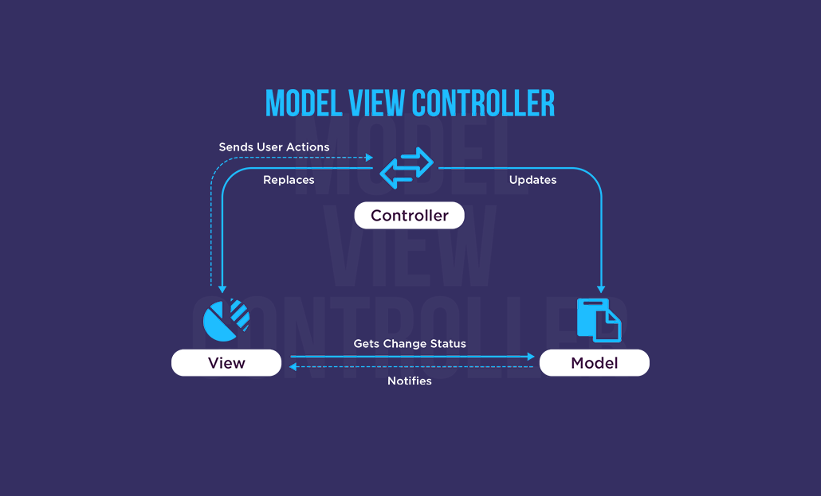

Slide 8
THANK YOU

